Slide 1

Grow Thy Crop
PSI HACKATHON
Cream of The Crop
Ethan Telep, Atharv Oak, Connery Tran

Slide 2

Roadmap
Stage 1
Stage 3
Data Analysis
Feature Engineering
Stage 2
Stage 4
Data Sanitization
Model Building and Prediction
CREAM OF THE CROP
10

Slide 3
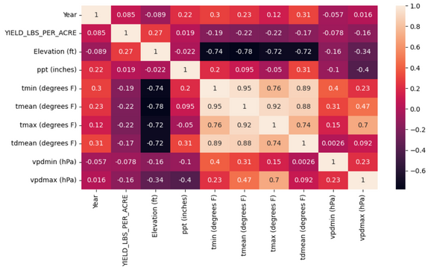
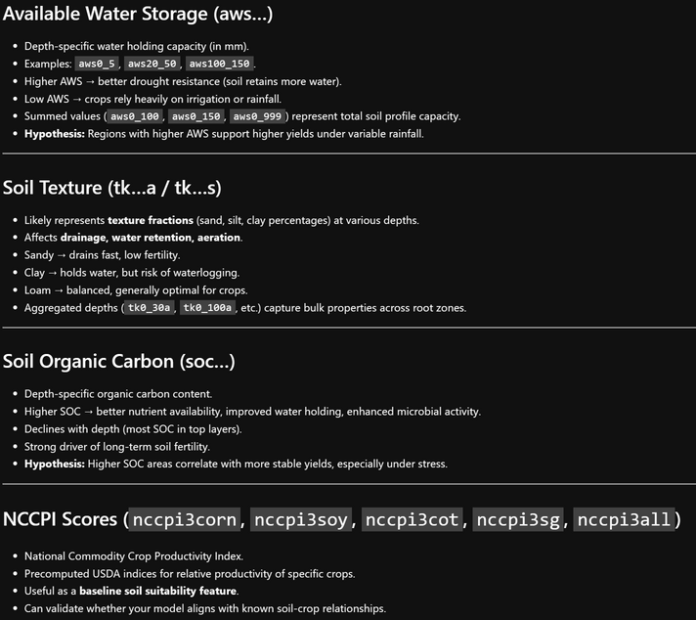
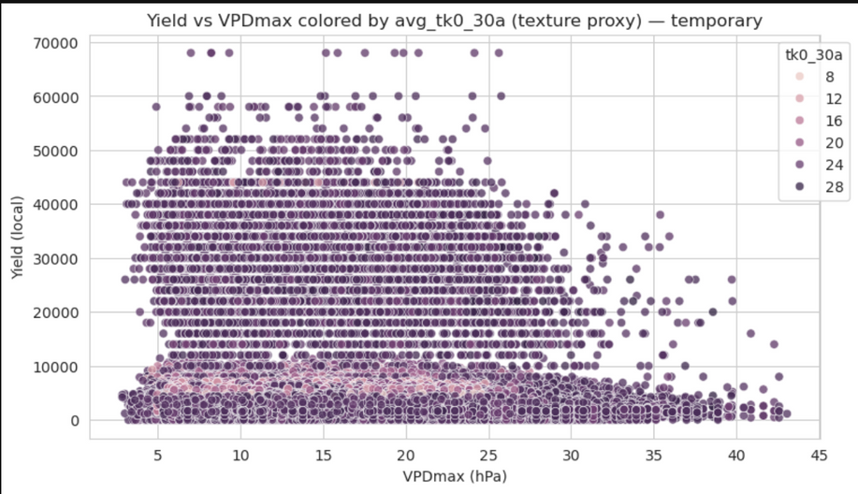
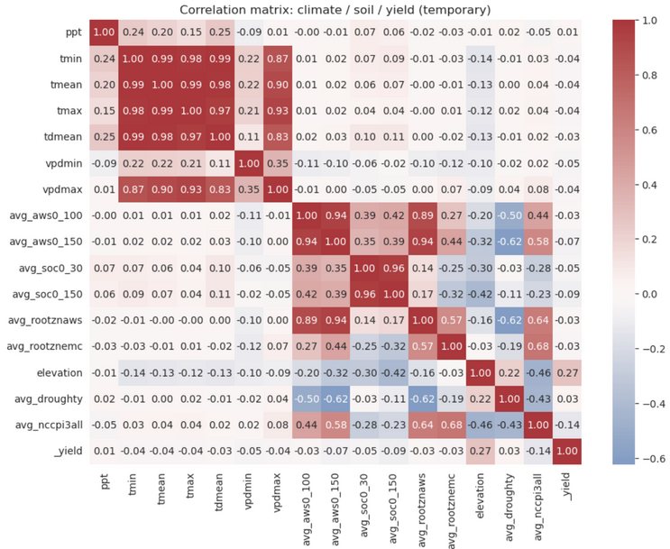
Data Analysis
Exploratory Data Analysis
Understanding relationships between data
process of inspecting and modeling data to find useful information
Building Domain Knowledge

Slide 4
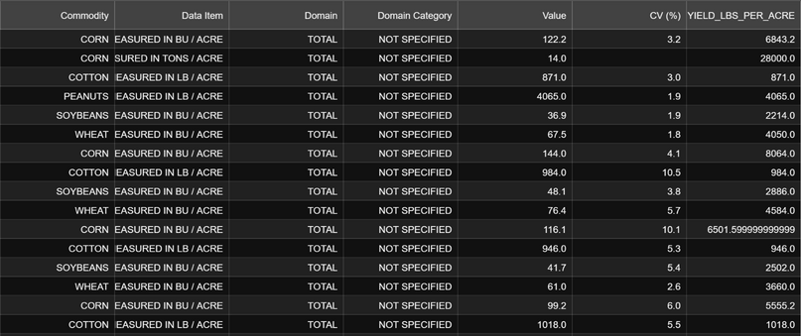
Data Sanitization
process of cleaning and preparing raw data by removing or correcting errors, duplicates, and inconsistencies to ensure its accuracy and reliability for analysis or modeling.
Data Profiling
Data Cleaning
Assessing the raw data to understand its content and quality.
Actively fix issues identified during profiling.
7

Slide 5
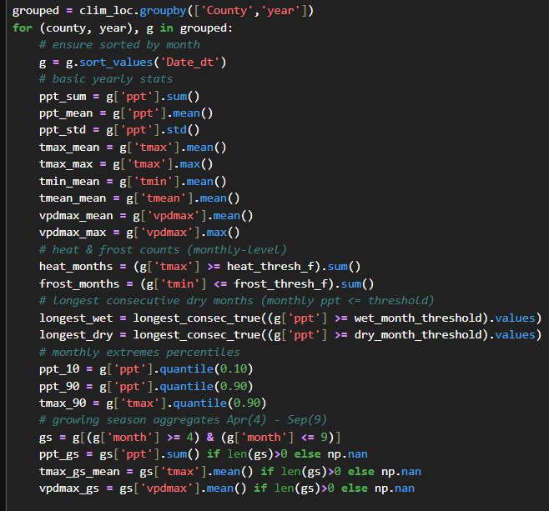
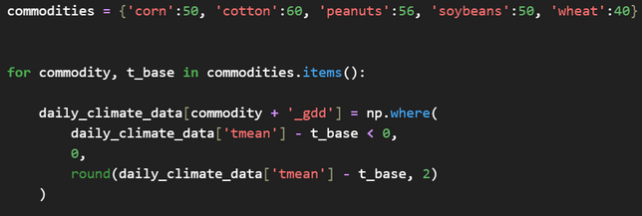
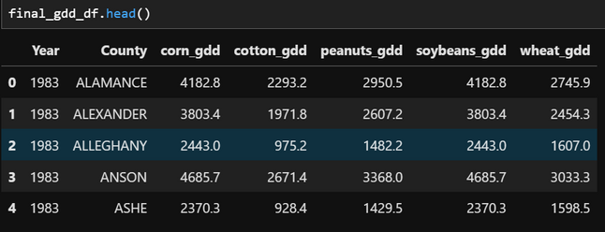
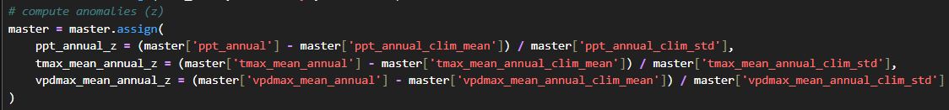
Feature Engineering
process of using domain knowledge to select and transform existing raw data into new variables that can improve the performance of a machine learning model.
Feature Creation/Transformation
building new features from existing ones.

Slide 6
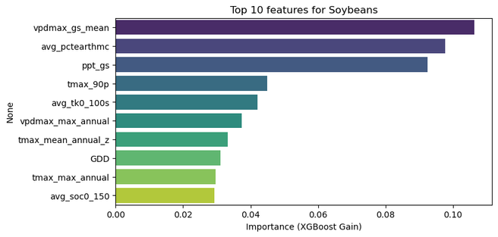
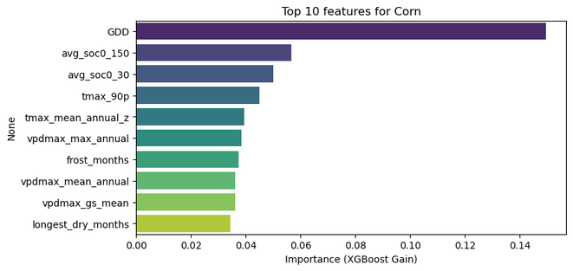
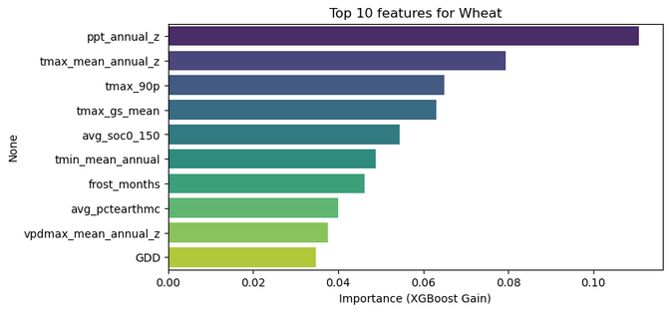
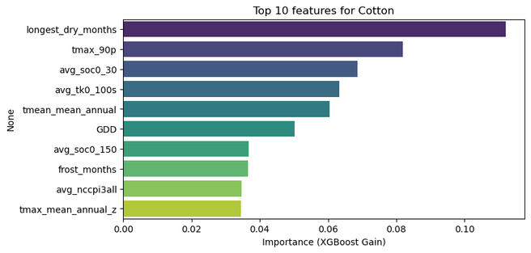
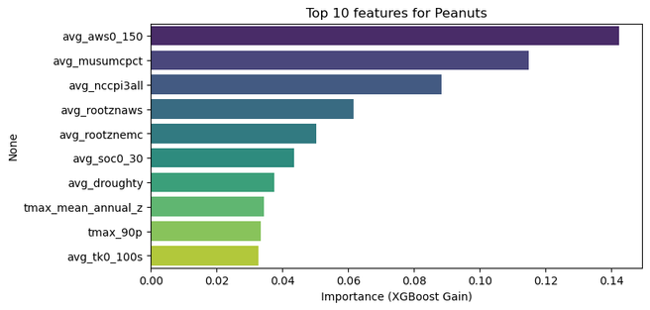
Feature Engineering

Slide 7
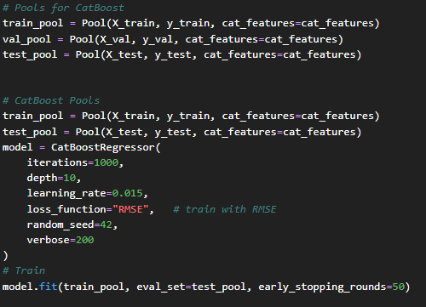
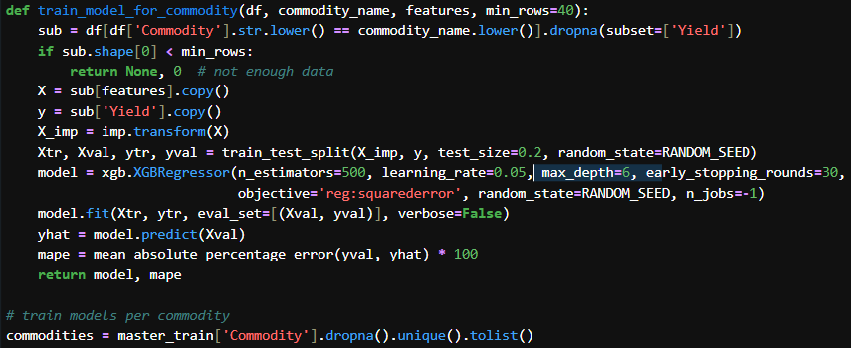
Model Building and Prediction
process of using a machine learning algorithm to learn patterns from prepared data and then using that learned model to forecast or predict outcomes on new, unseen data.
Model Building
Selecting and designing the machine learning algorithm
XG Boost Regressor
Cat Boost Regressor

Slide 8
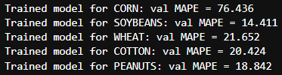

Model Building and Prediction
process of using a machine learning algorithm to learn patterns from prepared data and then using that learned model to forecast or predict outcomes on new, unseen data.
Model Prediction/Evaluation
Using the model to predict outcomes
XG Boost Regressor
Cat Boost Regressor

Slide 9
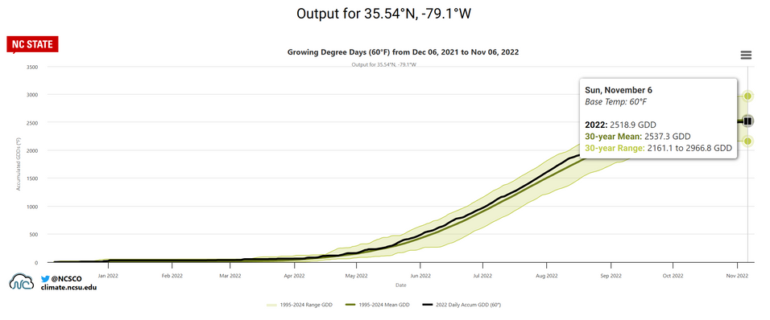
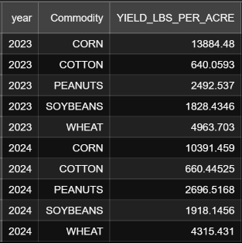
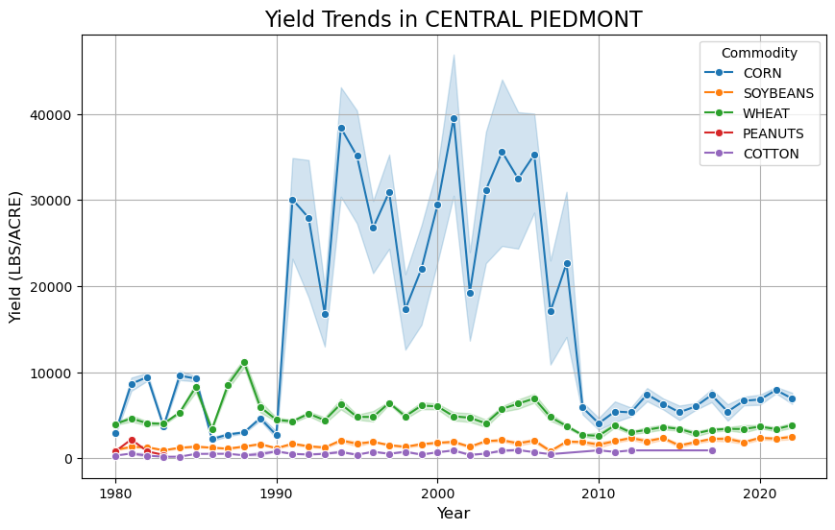
Key Takeaways
Data sanitization/analysis is A LOT of work
Domain knowledge is vital
The world is really noisy

Slide 10
Citations
"GDD Explorer." North Carolina State University, State Climate Office, State Climate Office of North Carolina, https://products.climate.ncsu.edu/ag/gdd-explorer/. Accessed 14 Sept. 2025.
XG Boost Regressor: https://xgboost.readthedocs.io/en/stable/python/python_api.html
Cat Boost Regressor: https://catboost.ai/docs/en/concepts/python-reference_catboostregressor
Data for Fertilizers: https://ers.usda.gov/sites/default/files/_laserfiche/DataFiles/50341/fertilizeruse.xls?v=13566

Slide 11
The End
THANK YOU FOR LISTENING
Cream Of The Crop

